Slide 1
Python Demo
By Bhadra Reddy

Slide 2
What is Python?
Python is a widely-used, interpreted, object-oriented, and high-level programming language
used for general-purpose programming
It was created by Guido van Rossum, and first released on February 20, 1991.
the name of the Python programming language comes from an old BBC television comedy sketch series called Monty Python’s Flying Circus.

Slide 3
Why Python?
Easy to learn:
It is very easy to learn compared to other programming languages(java)
Easy to use:
It is easy to use while writing new software and it’s often possible to write
code faster when using python, means improves the productivity.
Easy to understand:
It is also easier to understand someone else’s code if it is written in python
Easy to obtain:
Install and deploy - python is free.

Slide 4
Where we use python?
Python is great choice for:
Web and internet development (e.g, Django and Flask frameworks)
DevOps ( Automatic deployment of applications in production)
Data Science (Machine learning, AI)
Algo Trading in stock market
GUI applications
Automation Testing
Business applications (like amazon,)
Games

Slide 5
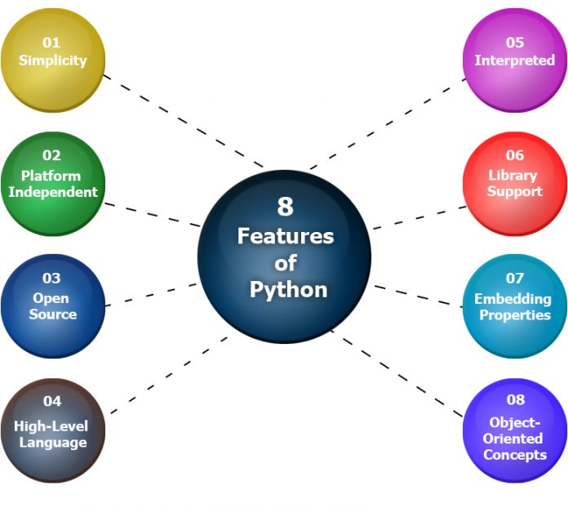
What are the features of python?

Slide 6
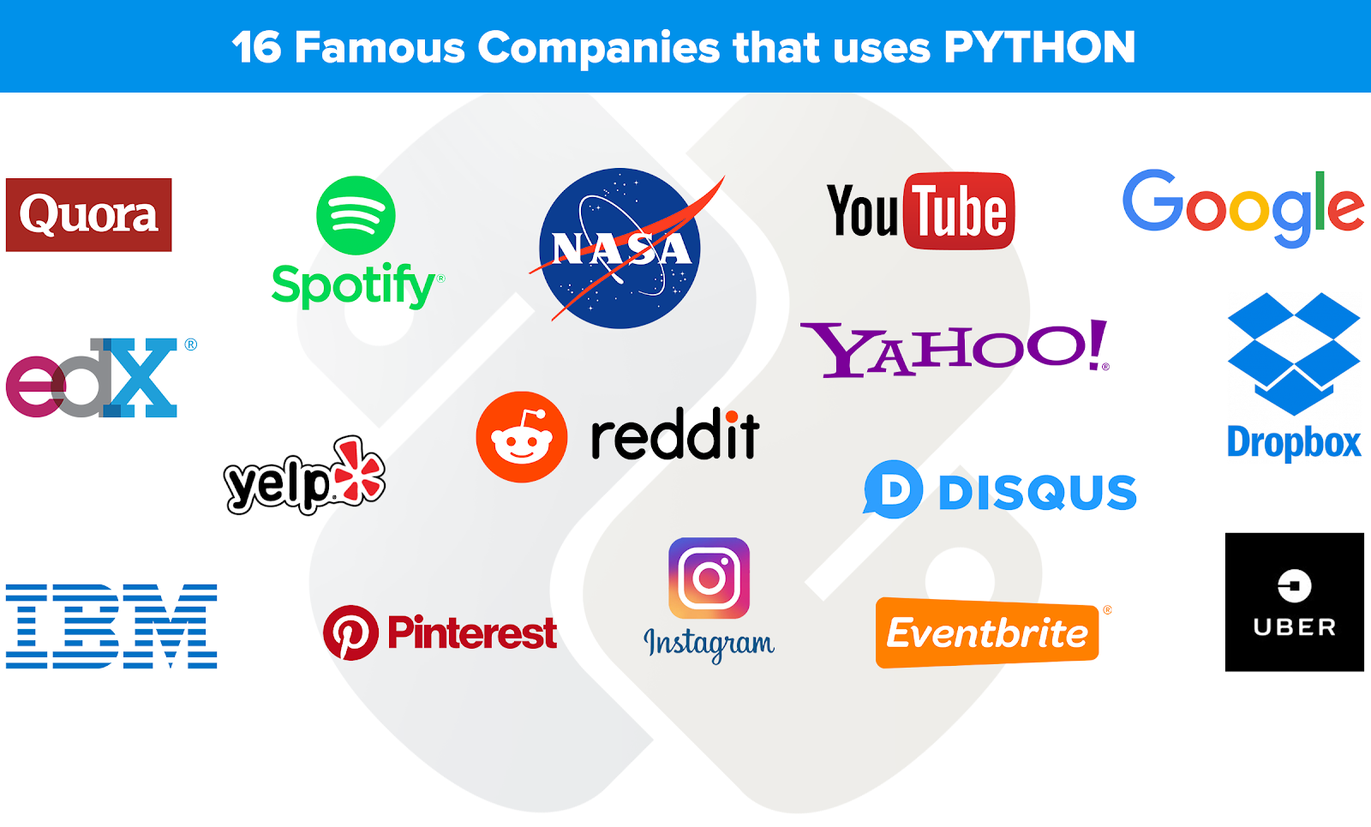
Application Types

Slide 7
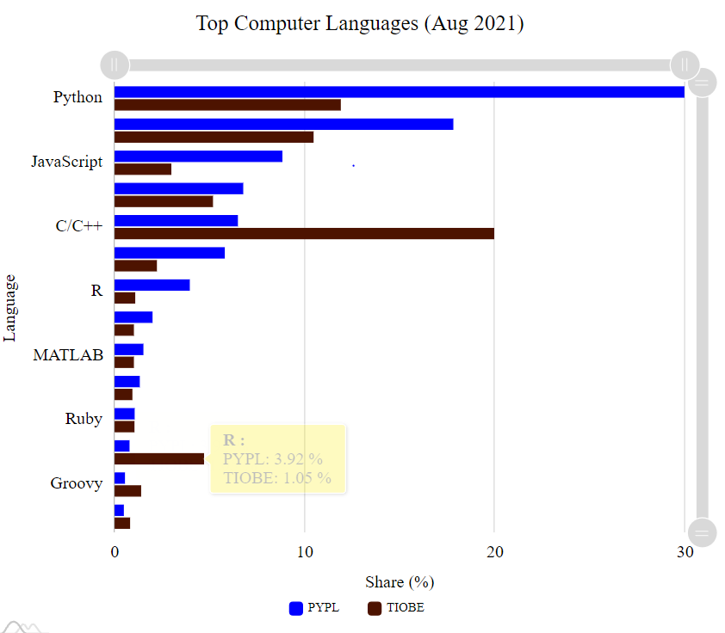

Slide 8
Writing simple python programs
# print message to screen
print(“Hello Learners, it is great choice to learn python”)
# Adding two number in python
a=10
b=20
output = a + b
print(output)

Slide 9
Q & A

